Slide 1
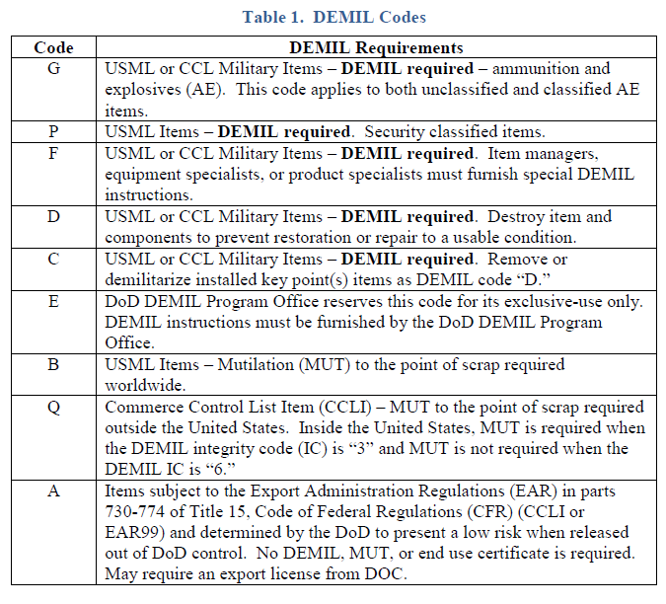
Demilitarization Code Validation
Notes:
.DoD Components use the DEMIL code validation as a quality control measure to verify the accuracy of DEMIL codes assigned to DoD personal property. The DDCMO administers the validation by assigning a code during the provisioning process, during the materiel disposition process, or at any time during the life-cycle of the item.

Slide 2
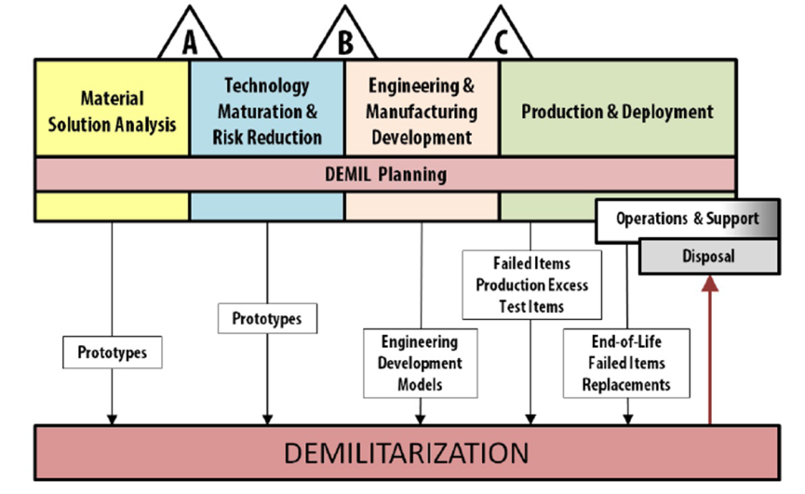
INTRODUCTION
DEMIL code validation is a quality control measure to verify the accuracy of DEMIL codes.
The DDCMO administers the validation:
during the provisioning process,
during the materiel disposition process, or
at any time during the life-cycle of the item.
Notes:
INTRODUCTION.
DoD Components use the DEMIL code validation as a quality control measure to verify the accuracy of DEMIL codes assigned to DoD personal property. The DDCMO administers the validation by assigning a code during the provisioning process, during the materiel disposition process, or at any time during the life-cycle of the item.

Slide 3
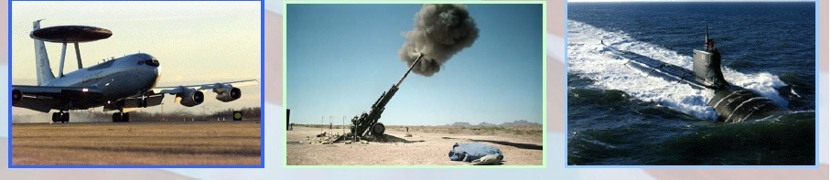
Eye Openers
Items coded as “No DEMIL required”
Airborne Warning and Control System (AWACS) Radome
High explosive artillery shell
Periscope
Notes:
Items coded as “No DEMIL required”
AWACS Radome – Table 11 Part 1 Category XI paragraph (a)(3) DEMIL Code “D”
High explosive artillery shell – Table 3 Category III paragraph (a) DEMIL Code “G”
Periscope – Table 19 Part 1 Category XX paragraph (c) DEMIL code “D”

Slide 4
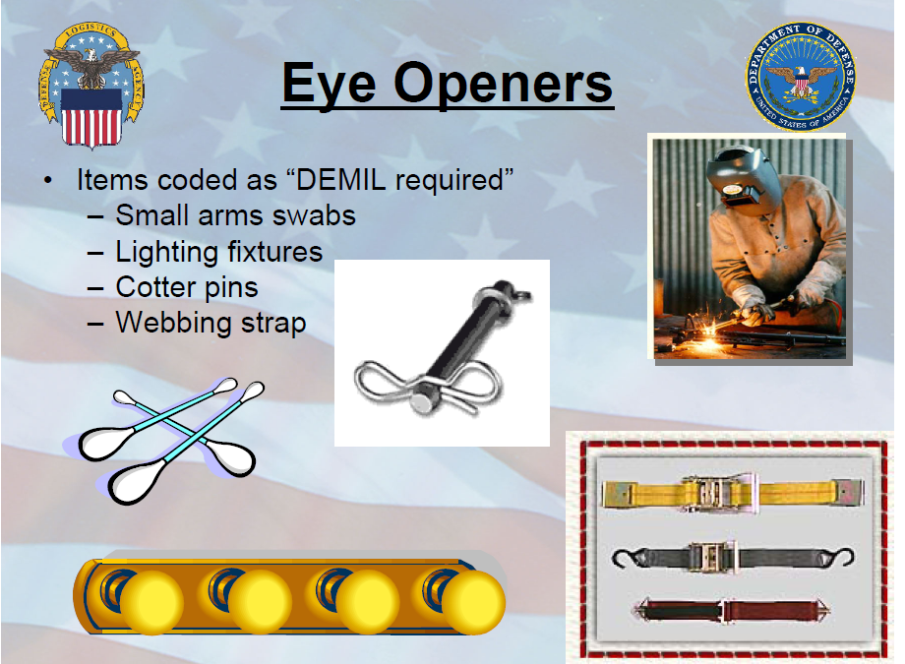
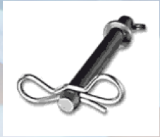
Eye Openers
Items coded as “DEMIL required”
Cotton swabs
Cotter pins
Light fixtures
Webbing straps
Notes:
Items coded as “DEMIL required”
Cotton swabs
Cotter pins
Light fixtures
Webbing straps
All DEMIL code A.

Slide 5
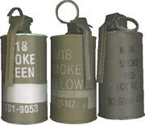
Example
DoD Demilitarization Coding Management Office (DDCMO) reviews and corrects miscoded items.
Typical Example
Smoke Grenade coded as DEMIL Code “A”
The coding was challenged for a change to DEMIL Code “G”.
Notes:
Past findings by the Demilitarization Coding Management office revealed numerous miscoded items.
An example is a NSN 1330-01-481-4425 Grenade, Hand, Non Lethal Smoke Composition -DEMIL Code A was requested change to code G because of the inherent danger of combustion and propellant used to create smoke effect. The item is clearly AE. This example was provided by the DDCMO.
Table 4 Part 2 ECCN 0A604 paragraph (c).

Slide 6
Other Examples
Nomenclature End Item Old Code
New Code
Antenna Cruise Missile A
Engagement Control Patriot Missile C
Radio Receiving Set Guardrail A
Personnel Carrier F/T M2, M2A2, M3 A
Award Plaque Suggestion Award B
Ship Anchor Combat Support Ship F
Chaplaincy LSP* Chaplain’s Field Desk B
Toilet Tank Assembly KC-135 B
D
P
D
C
A
A
A
A
**YOU SHOULD NOT RELY ON NOMENCLATURE ALONE TO MAKE YOUR DEMIL CODE DETERMINATION**
Notes:
Instructor Note: Custom Animation is setup to bring in everything except the new code. You can ask the students: What DEMIL code would they assign to these items. After they made their DEMIL code choice, you can then confirm with them the code DDCMO recommended.
Nomenclature End Item Old Code New Code
Antenna Cruise Missile A D
Engagement Control Patriot Missile C P
Radio Receiving Set Guardrail A D
Personnel Carrier F/T M2, M2A2, M3 A C
Award Plaque Suggestion Award B A
Ship Anchor Combat Support Ship F A
Chaplaincy LSP Chaplain’s Field Desk B A
Toilet Tank Assembly KC-135 B A
*LSP is a Logistical Support Package
You should not rely on nomenclature alone to make your DEMIL Code determination.

Slide 7
Purpose
Verify the accuracy of DEMIL codes assigned to DoD Personal Property.
**Percentage of inaccurate DEMIL code was calculated by using the number of codes changed divided by the number of new items.
Notes:
The purpose of this lesson is to:
Verify the accuracy of DEMIL codes assigned to DoD Personal Property.

Slide 8
Objective
Identify procedures and responsibilities for Demilitarization Code challenges.
Notes:
Our objective is to: Identify procedures and responsibilities for Demilitarization Code Validations.
Transition to next slide:
We will start by examining responsibilities.

Slide 9
Responsibilities
DoD DEMIL Coding Management Office (DDCMO)
Responsible for the administration and maintenance of the DEMIL Code Challenge Program.
Administers the revision of DEMIL codes when the Departments of State or Commerce revises export controls for items which are of low risk for release.
Inventory Control Point (ICP)
Responsible for timely resolution of items submitted for a challenge.
Notes:
Responsibilities
DDCMO is responsible for the overall program administration and maintenance of the DEMIL Code Challenge Program.
Administers the revision of DEMIL codes when the DOS or Department of Commerce revises export controls for items which are of low risk for release, and which can be processed for release with the limited TSC measures applicable to EAR99 items identified in DoDI 2030.08.
The Inventory Control Point is responsible for timely resolution of items submitted for a challenge.
The ICP is the organizational element within a DoD system which is assigned responsibility for material management of a group of items including such management functions as the computation of requirements, the initiation of procurement or disposal actions, distribution management, and rebuild direction

Slide 10
DEMIL Code Challenge Process
Any individual or activity, who has access to the DDCMO website, may initiate DEMIL code challenges.
DLA Disposition Service personnel generally submit DEMIL code challenges via Distribution Standard System (DSS) and Air Force use D143C (Now changing to FLITEs)
Items identified within a critical Federal Supply Class (FSC) or by a key word can help personnel identify DEMIL code challenge candidates.
**DEMIL code challenge process instructions**
Notes:
Initiate a Code Challenge
Initiation.
Any individual or activity who has access to the DDCMO Website at may initiate DEMIL code challenges.
DLA Disposition Service personnel generally submit DEMIL code challenges via Distribution Standard System (DSS).
Required entries for challenge submission are cited on the DDCMO Website.
Items identified within a critical Federal Supply Class (FSC) or by a key word can help personnel identify DEMIL code challenge candidates.
-DoDM 4160.28 Volume 1, Section 6, Page 21-24.

Slide 11
DEMIL Challenge Web Form
Department of Defense (DoD) Demilitarization (DEMIL)Coding Management Office (DDCMO) DEMIL challenge form
Notes:
Required Fields explanation:
1. Name: This field is mandatory. Fill in complete name. This should be the name of the individual who is submitting the form.
2. Phone: This field is mandatory. If submitter is providing a DSN (Government)
number, fill in the letters DSN. If the phone number is a commercial number, include area code and number. The extension field is not mandatory.
3. E-Mail Address: This field is mandatory. Please provide valid e-mail address for
coordination purposes
4. NSN (National Stock Number)
5. Current DEMIL code in FLIS (FLITEs)
6. DEMIL code you are recommending.
7. Rationale (more info provided on next slide)

Slide 12
DEMIL Challenge Web Form
Rationale to Support DEMIL Recommendation:
This clear text field is provided for the submitter to provide any and all rationale to substantiate the justification provided (i.e. history, or pertinent facts as possible).
**Technical Data, Specification or Standards, or pictures of the item can and should be provided via E-mail to DCMO@dla.mil**
Notes:
14. Rationale to Support DEMIL Recommendation: This is a mandatory field. This
clear text field is provided for the submitter to provide any and all rationale
substantiate the justification provided. The submitter is encouraged to provide as
much supporting rationale, history, or pertinent facts as possible. Technical Data,
Specification or Standards, or pictures of the item can and should be provided via Email
as shown above.

Slide 13
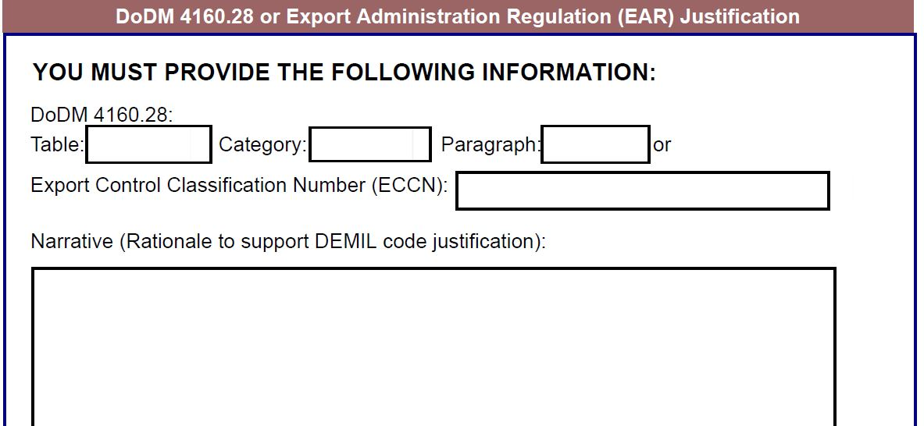
DEMIL Challenge Web Form
Notes:
DoDM 4160.28-V2
This is exactly the format you will also want to use when submitting changes through D143C (FLITEs now, as it will still go through battlecreek) your rationale will be the format in this slide
Per DoDM 4160.28
Then list the Table: the category: and the paragraph:
If you cant find it in Part 1, then you will go to part two and list the ECCN (Export Control Classification Number)
Then you will give a rationale

Slide 14
Justification
DoDM 4160.28-V2 justification is required for recommended DEMIL coding tables located:
https://www.dla.mil/Working-With-DLA/Federal-and-International-Cataloging/DEMIL-Trade-Security/DEMIL-Codes/
To recommend a DEMIL code of “Q”, submit the appropriate Export Control Classification Number (ECCN)

Slide 15
Code Challenge Process
DDCMO receives and evaluates the challenge.
Submit Challenge to ICP.
ICP evaluates and notifies DDCMO of results within 90 days of receipt.
If the ICP concurs, the DDCMO updates the DEMIL code is in FLIS.
If the ICP does not respond within the 90-day timeframe, then the DDCMO will formally change the DEMIL code in FLIS (forced concurrence).
DDPM and applicable Military Department DEMIL Program Administrator will make final DEMIL Code determination on unresolved challenges.
Notes:
The DDCMO will evaluate, validate, and process the challenge within 10 days of receipt.”
For challenges forwarded to the ICP, the responsible entity will evaluate the challenge and notify the DDCMO of results within 90 days of receipt. If the responsible ICP activity concurs with the DDCMO recommended demilitarization code and a change is required, the ICP entity will ensure changes are submitted to the DoD/Federal Agency legacy system and that the change is recorded in the FLIS within 90 days of the initial receipt of the challenge request.”
The DDCMO will monitor ICP notifications and FLIS changes and, in the event that the ICP has not responded within 90 days, the DDCMO will assume concurrence and initiate action to change the DEMIL Code to the recommended DDCMO code in the FLIS. If the ICP entity has concurred with the DDCMO recommended DEMIL Code, or replies to the challenge with a valid change to the DDCMO recommended code but has not effected FLIS change within 90 days, thee DDCMO will initiate action to update the FLIS. These actions will be identified in the FLIS with a code that represents a “forced concurrence”.
DDPM and applicable PM will make final determination for challenges that cannot be resolved between DDCMO and ICA.

Slide 16
Coordination with Military Departments
DDCMO will coordinate DEMIL code challenges with the appropriate Military Department for review prior to initiating any changes.
Military Departments may enter into memorandums of agreement with the DDCMO to improve coordination and processing of DEMIL challenge actions.
Notes:
All DEMIL code challenges will be coordinated with the appropriate Military Department for review, prior to any changes taking place.
Military Departments may enter into Memorandums of Agreement with the DDCMO to improve coordination and processing of DEMIL challenge actions.

Slide 17
DEMIL Integrity Codes
DEMIL Integrity Codes (IC) appear adjacent to the DEMIL code in the FLIS. The DEMIL IC indicates the results of the validation.
A validated DEMIL code is one with an associated DEMIL IC of “1,” “3,” “6,” or “7.” (This does not preclude the item from being code challenged).
Notes:
DEMIL Integrity Codes (IC) appear adjacent to the DEMIL code in the FLIS. The DEMIL IC indicates the results of the validation.
A validated DEMIL code is one with an associated DEMIL IC of “1,” “3,” “6,” or “7.”

Slide 18
DEMIL IC Descriptions
Blank | DEMIL code has not been reviewed by DCMO.
0 | DEMIL code reviewed by DCMO. Recommended DEMIL code and current ICP DEMIL code are not equal. Presently in collaboration cycle.
1
2 | DEMIL code reviewed by DCMO and accepted by ICP (DEMIL IC “1”) however, ICP has since overridden or changed code. NO LONGER VALID
DEMIL code reviewed by DDCMO, recommended DEMIL code adopted by ICP, or no DEMIL code change recommended.
Notes:
Blank DEMIL code has not been reviewed by DLIS.
0 DEMIL code reviewed by DDCMO. Recommended DEMIL code and current ICP
DEMIL code are not equal. Presently in collaboration cycle.
DEMIL code reviewed by DLIS, recommended DEMIL code adopted by ICP, or no DEMIL code change recommended.
**DEMIL code reviewed by DDCMO and accepted by ICP (DEMIL Integrity Code =1) however, ICP has since overridden/changed**. NO LONGER VALID
inventory control point — An organizational unit or activity within a Department of Defense supply system that is assigned the primary responsibility for the materiel management of a group of items either for a particular Service or for the Defense Department as a whole. Materiel inventory management includes cataloging direction, requirements computation, procurement direction, distribution management, disposal direction and, generally, rebuild direction. Also called ICP.

Slide 19
DEMIL IC Descriptions
3
4 | DEMIL code could not be validated - insufficient technical data available.
5 | Either: (1) Item reviewed and coded by Service or agency ICP without DCMO collaboration; or, (2) Service or agency ICP changed the DEMIL code prior to completion of DEMIL IC “0” review or collaboration cycle.
6
Critical Federal supply class (FSC) or Federal supply group (FSG) munitions list item (MLI) or Sensitive commerce control list item (CCLI) Requires mutilation worldwide.
Non-Sensitive CCLI. Requires MUT overseas.
Notes:
3 Restricted items or sensitive CCLI. Requires mutilation worldwide.
4 DEMIL code could not be validated - insufficient technical data available.
5 (1) Item reviewed and coded by Service/Agency ICP – without DDCMO collaboration; or, (2) Service/Agency ICP changed the DEMIL code prior to completion of IC-0 review/collaboration cycle.
Non-Sensitive CCLI. Requires mutilation overseas.
When it comes to DEMIL code “Q” IC3 or IC6 will be used in conjunction with

Slide 20
DEMIL IC Descriptions
7
8 | ICP has non-concurred with a DDCMO recommended DEMIL Code. Item DEMIL coding pending resolution.
9 | Reserved for future use.
Forced Concurrence. DDCMO has forced a DEMIL code change in FLIS. ICP has not responded to collaboration request (over 90 days old) or failed to update the DEMIL code in the ICP’s legacy system.
Notes:
7 Forced Concurrence. DDCMO has forced a DEMIL code change in FLIS. ICP has not responded to collaboration request (over 90 days old) or failed to update the DEMIL code in the ICP’s legacy system.
ICP has non-concurred with DDCMO recommended DEMIL Code. Item DEMIL coding pending resolution.
9. Reserved for future use.

Slide 21
DEMIL Code Lock
DoD Components will initiate a lock on DEMIL codes with DEMIL IC of "1", “3”, “6”, or "7" to prevent arbitrary changes.
The ICP retains absolute authority to request a change provided the change is fully coordinated with the DDCMO for validation and concurrence.
To initiate a change to a DEMIL code that contains an IC of "1", “3”, “6”, or "7", submit an e-mail to the DDCMO through the applicable Military Service DEMIL Program for coordination and resolution.
Notes:
DoD Components will initiate a lock on DEMIL codes with DEMIL IC of "1", “3”, “6”, or "7" to prevent arbitrary changes.
The ICP retains absolute authority to request a change provided the change is fully coordinated with the DDCMO for validation and concurrence.
To initiate a change to a DEMIL code that contains an IC of "1", “3”, “6”, or "7", submit an e-mail to the DDCMO through the applicable Military Service DEMIL Program for coordination and resolution.

Slide 22
DEMIL IC Descriptions
DEMIL Code
DEMIL IC
Notes:
Screenshot of WebFLIS.

Slide 23
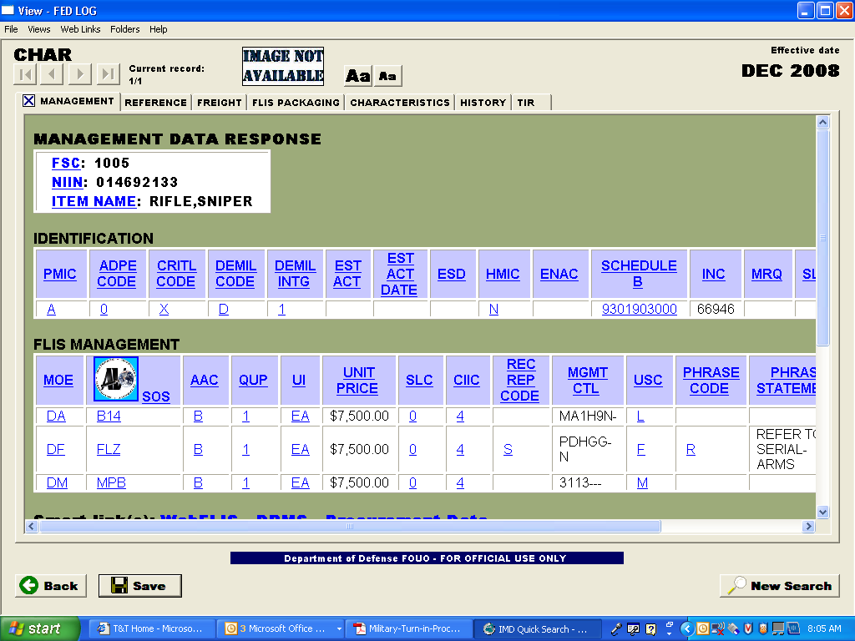
DEMIL Code
DEMIL IC
Notes:
Screenshot of FEDLOG

Slide 24
Total NSN’s
17.1 Million Total NSN’s – (7.4M active, 9.7 inactive/cancelled)

Slide 25
Demilitarization Codes Assigned
to NSN in FLIS

Slide 26
Practical Exercise
Task: | Decide whether an item requires a challenge
Condition: | Collaborating as a group with: An incomplete worksheet Classroom reference materials General characteristics for each item
Standard: | Recommend if the item needs to be challenged

Slide 27
Review Questions
Who makes the final determination for unresolved challenges?
What must be included to request a change from DEMIL Code “B” to “D”?
What does DEMIL Code “Q” with a DEMIL IC “6” indicate?
What must be included to request a change to DEMIL Code “Q”?
DoD DEMIL Program Manager and applicable Military Department DEMIL Program Administrator
Non-Sensitive CCLI.
What are the mutilation requirements?
Table, Part 1 from DEMIL coding tables
Applicable ECCN
Notes:
Review Questions
Who makes the final determination for unresolved challenges?
Answer: DoD DEMIL Program manager and applicable Military Department DEMIL Program Administer.
What must be included to request a change from DEMIL Code “A” to “B”?
Answer: Table, Part 1 from volume 2.
What must be included to request a change to DEMIL Code “Q”?
Answer: Applicable Export Classification Number (ECCN)
What does DEMIL Code “Q” with a DEMIL IC “6” indicate?
Answer: Non-Sensitive CCLI. Requires mutilation overseas.

Slide 28
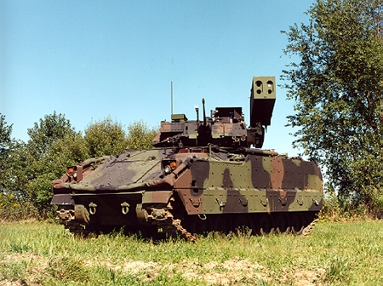
?
code_challenge
Notes:
Remember until DDCMO discovered the error someone had this Fighting Vehicle DEMIL Code A. This is the “M6 Linebacker” that is a Bradley Fighting Vehicle configured for an Air Defense Role. The operators are able to fire “Stinger” surface to air missiles from inside the vehicle. The code was changed to Code C.
(Personnel Carrier Full Tracked M2, M2A2, M3) NSN 2350-01-448-0368
This is why the DEMIL Challenge Program is so important. We have a Program and process to identify and correct Miscoded items.
Any Questions?

